Slide 2

Purpose of this presentation
TAXONOMIES

Slide 3
Problem 1: ISOLATED TAXONOMIES

Slide 4
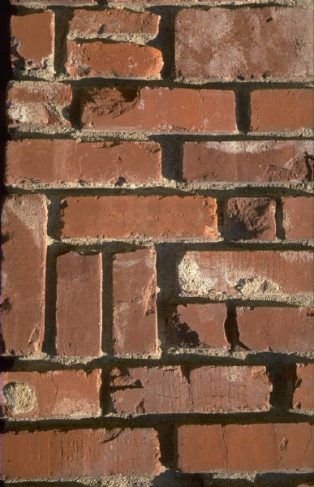
COREP AND FINREP DICTIONARIES ARE ISOLATED
COREP 2006
FINREP 2006

Slide 5
SOLUTION: A COMMON DICTIONARY OF CONCEPTS
Dictionary
* Assets
* Capital requirements
* Counterparty (Dim)
* Changes in assets
* Public sector (Dom member)
Definition of tables
COREP 2012
FINREP 2012

Slide 6
SOLUTION: A COMMON DICTIONARY OF CONCEPTS
CEBS
Dictionary
Common
Dictionary
ECB
Dictionary
* …
* …
* ….
* ….
* ….
* ….
* …..
* …..
* …..
* …..
* …..

Slide 7
Problem 2: IMPACT OF NEW VERSIONS

Slide 8

IDENTIFYING A CONCEPT IN An instance document
Applications must not be based on prefixes but qualified names
TAXONOMY
Cx = Assets, credit, stock
x1 = Fair value
…
dim:CP (prefix:local-name)
xmlns:dim=“http://www.c-ebs.org/.../dimension”
{http://c-ebs.org/…/dimension}CP
This is called a “qualified name”
100.000 € Cx, x1, y5, z3
250.000 € Cx, x2, y5, z3
…
INSTANCE DOCUMENT

Slide 9
IMPACT OF NEW VERSIONS ON CREDIT INSTITUTIONS
http://www.c-ebs.org/eu/fr/esrs/finrep/t-FINREP/2006-09-30
TAXONOMY 2012
Assets =>
{.../2012}/Assets
TAXONOMY 2014
Assets =>
{.../2014}/Assets
V 2012
V 2014

Slide 10

IMPACT OF NEW VERSIONS ON ANALYSTS
2013 Balance Sheet
(2012 TAXONOMY)
{.../2012}/Assets 20.000
2014 Balance Sheet
(2014 TAXONOMY)
{.../2014}/Assets 26.000

Slide 11
IMPACT OF NEW VERSIONS ON SUPERVISORS (validation rules)
if Assets > 500% Assets[Previous year] then raise a warning
To compare 2013 and 2012:
if {2012}Assets[t] > 500% {2012}Assets[t-1] then ...
To compare 2014 and 2013:
if {2014}Assets[t] > 500% {2012}Assets[t-1] then ...
To compare 2015 and 2014:
if {2014}Assets[t] > 500% {2014}Assets[t-1] then ...

Slide 12
IMPACT OF NEW VERSIONS ON SUPERVISORS (validation rules)
Validation rules that compare data in FINREP, COREP and STATISTICS
2012
2013
2014
2015
COREP
FINREP
STATISTICS
Validation rules x 8

Slide 13


The genesis of a “best” practice

Slide 14

The genesis of a “best” practice

Slide 15
The genesis of a “best” practice

Slide 16
The genesis of a “best” practice

Slide 17
The genesis of a “best” practice

Slide 18

The genesis of a “best” practice
BASED ON A TRUE STORY
NO MONKEYS WERE HARMED DURING THE MAKING OF THESE SLIDES

Slide 19
SOLUTION: STABLE QNAME NAMESPACES
NO DATE IN NAMESPACES
Dictionary
2012 BASE DICTIONARY
http://www.eurofiling.info/base
* mi1 (Assets)
* md1 (Changes in Assets)
...
2014 BASE DICTIONARY
http://www.eurofiling.info/base
* mi1 (Assets)
* md1 (Changes in Assets)
* mi25 (New 2014 concept)
But I need different versions at the same time!!! How can I do it ???
Definition of tables
FINREP 2012
FINREP 2014
t

Slide 20
VERSION OF A SET VS VERSION OF INDIVIDUAL ELEMENTS
SET Version 1
SET Version 2
A
B
A change in the namespace of a schema file impacts the content
B
D
D
C
C
E
E
G
I
F
H

Slide 21
HOW VERSIONS ARE IDENTIFIED
URL: http://.../2012/file.xsd
Base elements dictionary (v2012)
schemaRef href=“...”
{http://...}mi1 2.000€
{http://...}mi2 2.500€
{http://...}mi3 20€
{http://...}mi4 8.880€
...
Tables def (2012)
URL: ../base.xml
URL: ./dim.xml
URL: ./table-ca.xml
URL: ./table-cr.xml
Dimensions dictionary (v2012)
Table CA (2012)
Table
CR (2012)
TAXONOMY
(TABLES DEF)
Base elements dictionary (v2014)
Tables def (2014)
URL: http://.../2014/file.xsd
URL: ../base.xml
URL: ./dim.xml
URL: ./table-ca.xml
URL: ./table-cr.xml
Dimensions dictionary (v2014)
Table CA (2014)
Table
CR (2014)
INSTANCE DOCUMENT

Slide 22
ABSOLUTE / RELATIVE URLs AND URI RESOLVERS
Absolute URLs must be used across domains
  From instance files to taxonomy files (link to BDE taxonomy catalog)
  From national taxonomy extensions to European files
  Between taxonomies from different authorities
Relative URLs should be used inside a domain
URI resolvers (e.g. OASIS catalog) should be used to map external URLs to internal ones in production systems
  Solves security issues
  Improves reliability
  Improves availability
  Folder structure independency
Two common implementation mistakes
Use of relative URLs in instance files
XML files cache systems based on:
  Namespace
  - File name (not complete URL)

Slide 23
W3C XML SCHEMA EXCERPT
The processor is free to access or construct components using means of its own choosing
When a schemaLocation is present, it must contain a single URI reference which the schema author warrants will resolve to a serialization of a ·schema document· containing the component(s) in the <import>ed namespace referred to elsewhere in the containing schema document.

Slide 24
IMPACT ON CREDIT INSTITUTIONS SOLVED
TAXONOMY 2012
Assets =>
{http://www.eurofiling.info/base}/mi1
TAXONOMY 2014
Assets =>
{http://www.eurofiling.info/base}/mi1
2012
2014

Slide 25
IMPACT ON ANALYSTS SOLVED
2013 Balance Sheet
(2012 TAXONOMY)
{...}/Assets 20.000
2014 Balance Sheet
(2014 TAXONOMY)
{...}/Assets 26.000

Slide 26
IMPACT ON validation rules SOLVED
Validation rules that compare data in FINREP, COREP and STATISTICS
2012
2013
2014
2015
COREP
FINREP
STATISTICS
Validation rules x 1

Slide 27
Problem 3: missing link between tables published and the taxonomy DICTIONARY

Slide 28
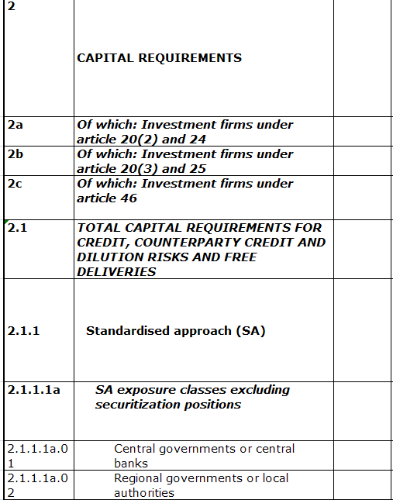
PROBLEM FOR INSTANCE preparers
?
XBRL REPRESENTATION
base item: p-cm-ca:CreditRiskCapitalRequirements
d-cr:CreditRiskDimension =
d-cr:CreditRiskSACreditCounterpartyCreditDelivery
d-ec:ExposureClassDimension =
d-ec:SAECRegionalGovernmentsLocalAuthorities

Slide 29
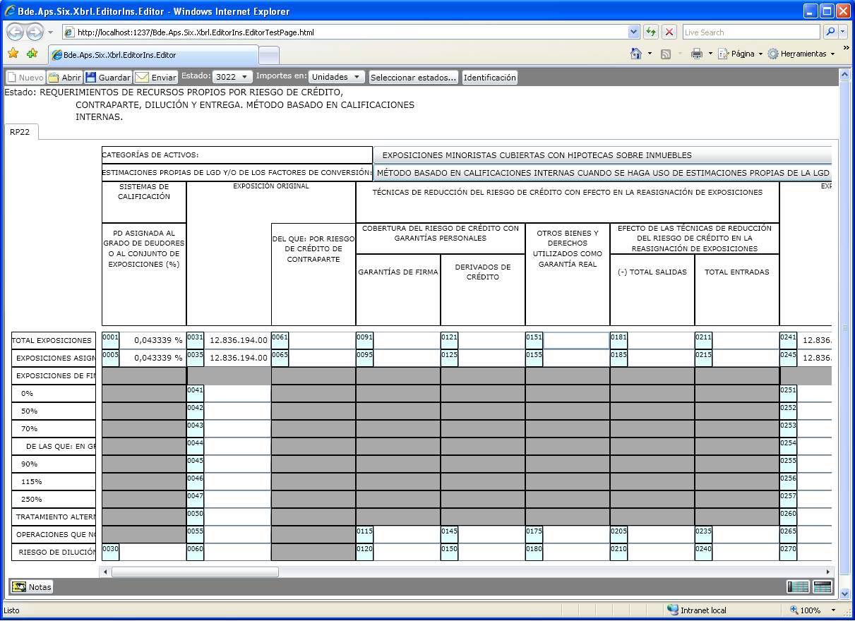
Problem for software developers
?
FORMAT
INFORMATION
TAXONOMY
Balance Sheet
XBRL file

Slide 30
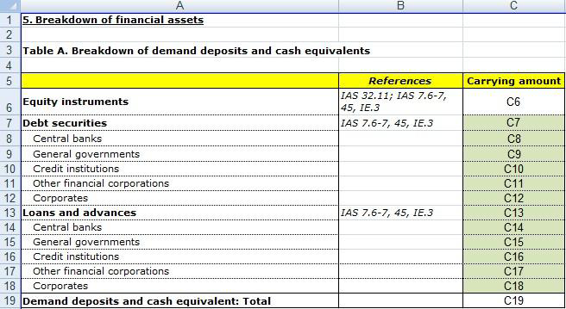
CONSTRAINTS ON LEGAL REFERENCES AND LABELS
XBRL Labels and References are limited to
individual elements !!!

Slide 31
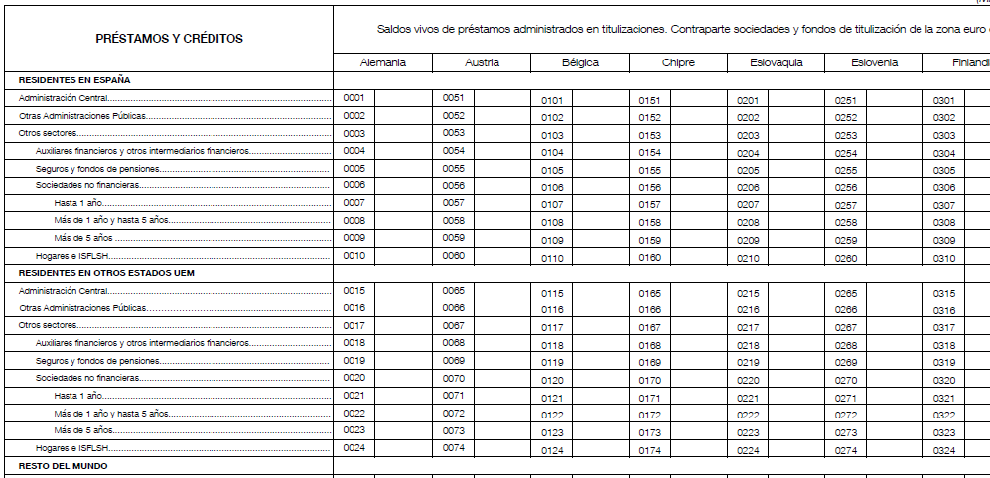
LIMITATIONS ON THE VALIDATIONS DEFINITION PROCESS and error REPorting
Validation rules for table XXX
0003 = 0004 + 0005 + 0006 + 0010
0006 = 0007 + 0008 + 0009
0017 = 0018 + 0019 + 0020 + 0024
0020 = 0021 + 0022 + 0023
0053 = 0054 + 0055 + 0056 + 0060
0056 = 0057 + 0058 + 0059
0067 = 0068 + 0069 + 0070 + 0074
0070 = 0071 + 0072 + 0073
0103 = 0104 + 0105 + 0106 + 0110
0106 = 0107 + 0108 + 0109
0117 = 0118 + 0119 + 0120 + 0124
0120 = 0121 + 0122 + 0123
0153 = 0154 + 0155 + 0156 + 0160
...
Becomes a single XBRL Formula
$x = sum($breakdown)

Slide 32
LIMITATIONS ON error REPorting capabilities
INSTANCE DOCUMENT
ERROR REPORT
The following test in table XXX has failed:
0003 = 0004 + 0005 + 0006 + 0010 !!!!

Slide 33
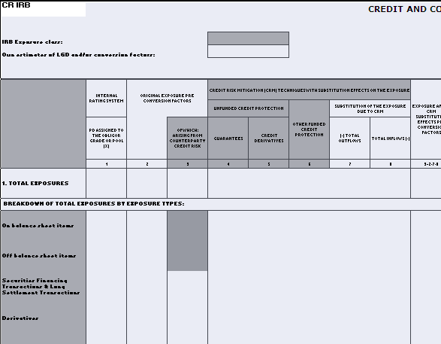
Solution: rendering information must be included in xbrl taxonomies
Rendering approach suggested to XBRL Int., implemented in Banco de España’s ECB statistics project and to be implemented in FINREP and COREP
Axys 1 (Z)
Axys 2 (Z)
Table
Axys (X)
Axys (Y)

Slide 34
Axys detail
Primary item: Assets
Amount: Carrying amount
Category: Held for trading
Cons. Scope: CRD

Slide 35
VIEW / DICTIONARY LINK PROBLEMS SOLVED!
Instance preparers: Link to COREP tax viewer
Instance visualization tools: Link to ECB statistics instance editor
Labels and references
Validations definition process improved
Table oriented error reporting possible

Slide 36
conclusions
New approach:
  Solves some limitations on current taxonomies
  It will also enable new features
It is important to be familiar with these changes
XBRL standard approach. Not blindly aligned to “best practices”
It may raise bugs in current products and implementations

